Slide 1
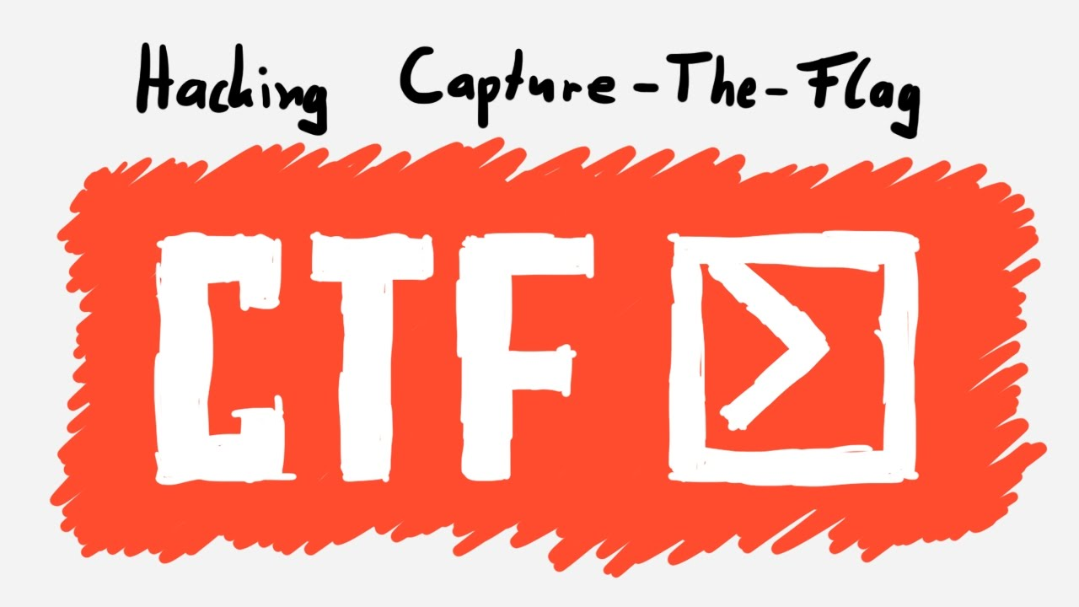
Introduction to
Capture The Flag (CTF)

Slide 2

About me
0xdaro
Web Developer
Newbie CTF Player

Slide 3
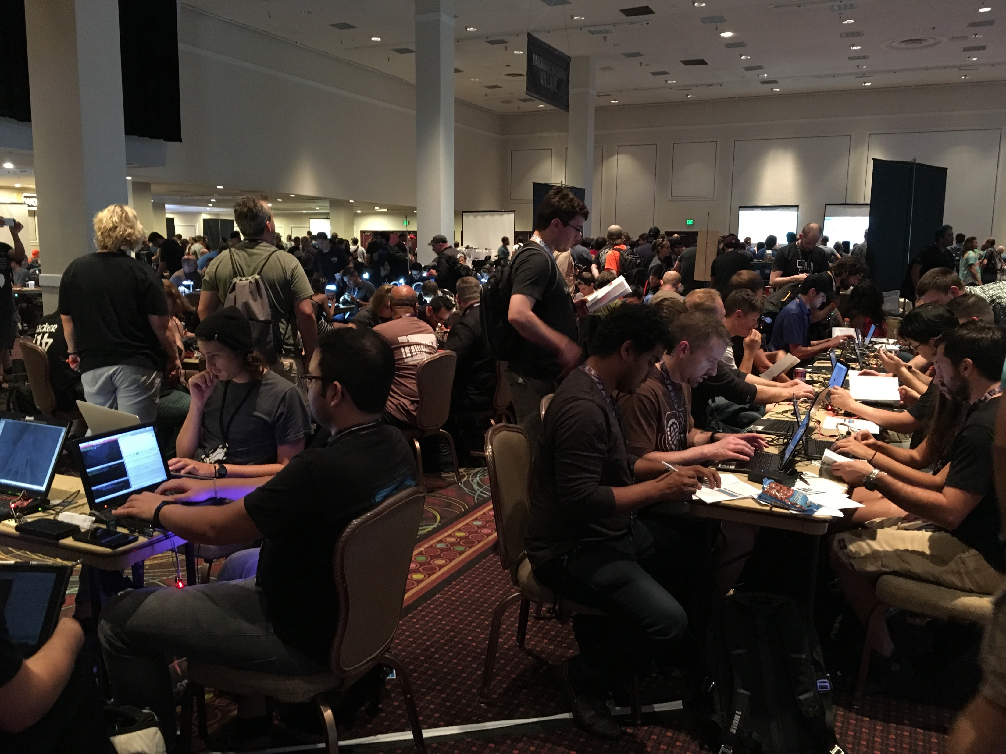
What is Capture The Flag?
Information Security Competition

Slide 4
Styles of CTF
Jeopardy (Common)
Multiple Categories of Problems
Attack and Defense (Advance)
Given a machine (or a small network)
Attack other people’s machine and defend your own machine

Slide 5
Problem Categories
Forensics
Reverse
Web
Pwn
Misc
Crypto

Slide 6



Reverse
Download
Find Key
Earn Points

Slide 7

Pwn
Download
(Some problem no given file)
Find exploitable
vulnerabilities
Use exploitable vulnerabilities to get shell
Connect to server
Earn Points

Slide 8
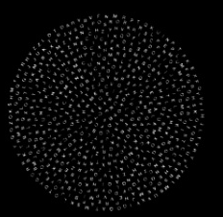

Crypto
Various source
Web, File, String, hardware…
Apply Math
(Cryptography)
Earn Points

Slide 9

Web
OWASP TOP TEN

Slide 10

Forensics
File
Earn Point
Apply Analysis,
Simulation…

Slide 11

Misc
Various source
Web, File, String, hardware…
Earn Points
Play with puzzle

Slide 12

Where can I play CTF?
https://ctftime.org

Slide 13
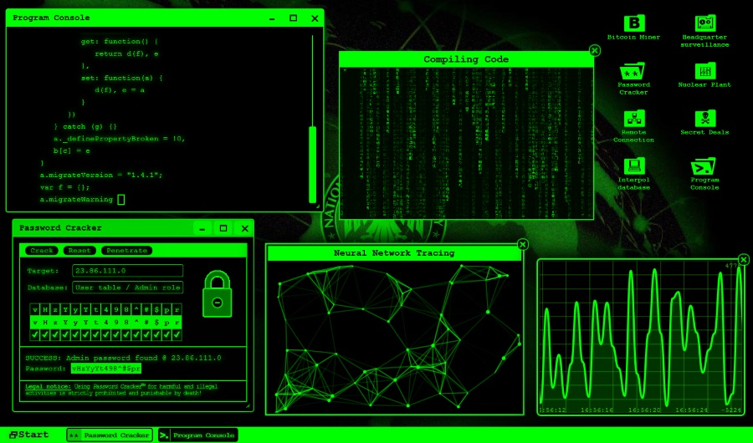
Awesome CTF Tools
https://github.com/apsdehal/awesome-ctf/blob/master/README.md

Slide 14
DEMO

Slide 15
THANK YOU

